Slide 1
What is a Class?

Slide 2
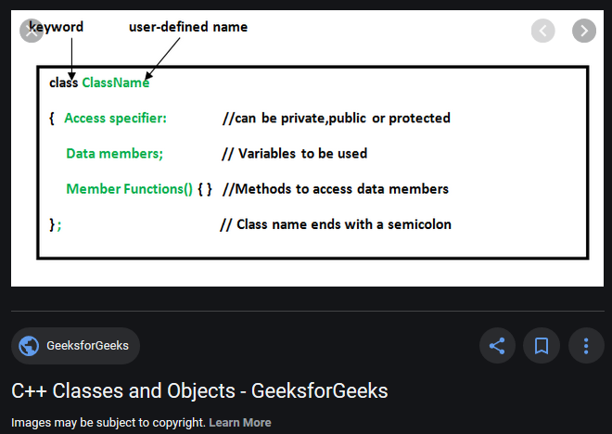
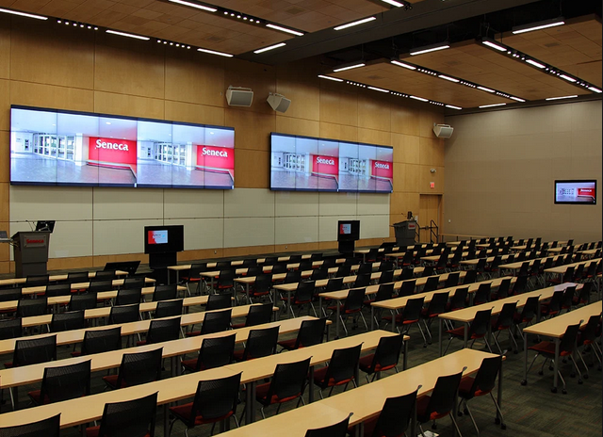
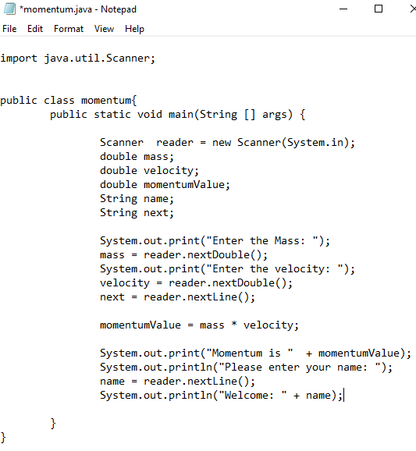
What is a class?
OOP244 Definition:
We describe the structure of similar objects in terms of their class. Objects of the same class have the same structure, but possibly different states. The variable types that describe their states are identical, but generally have different values.

Slide 3
Expanding the definition of a class
At this point these classes are just “ideas”; they are not software classes—some may turn into software classes and some may not.
Some may become classes that hold data (attributes), others may become controllers (programs) that manage the data classes and interactions with other domains.
As we identify classes we look for potential properties—we call these attributes. Attributes could become the data that a class carries and is responsible for.

Slide 4
Analyzing Information Requirements
First step in Systems Design
Review existing documentation
Analyze existing systems
Interviews
Document business processes

Slide 5
Concepts as classes
Information Concepts we identify are drawn as classes in a UML domain class diagram.
At this point these classes are just “ideas”; they are not software classes—some may turn into software classes and some may not.
Some may become classes that hold data (attributes), others may become controllers that manage the data classes and interactions with other domains.
As we identify classes we look for potential properties—we call these attributes. Attributes could become the data that a class carries and is responsible for.

Slide 6
UML Domain Class
Represents some concept—physical or electronic or recorded—that is used, and probably needs to be remembered, in a domain such as a business.
The class defines the “template” for the concept; specific instances are objects instantiated from the class template. For example the objects Easter Lily, Tea Rose, and Tulip might be objects of the class Flower
The class defines the “template” for the concept; specific instances are objects instantiated from the class template. For example the objects Easter Lily, Tea Rose, and Tulip might be objects of the class Flower

Slide 7
UML Domain Class continued
Objects:
name “Easter Lily”, description “a white, spring flowering lily“
name “Tea Rose”, description “a garden rose with flowers having a subtle tea scent”
name “Tulip”, description “a spring flowering plant that grows from a bulb and has cup-shaped flowers. It is from the lily family”

Slide 8
What is a domain model?
A domain model is a visual representation—a picture--of the concepts or physical things that are involved in the domain we are modeling.
The domain might be a business process, an engineering process...something that we are hoping to automate with a software system.

